Slide 1
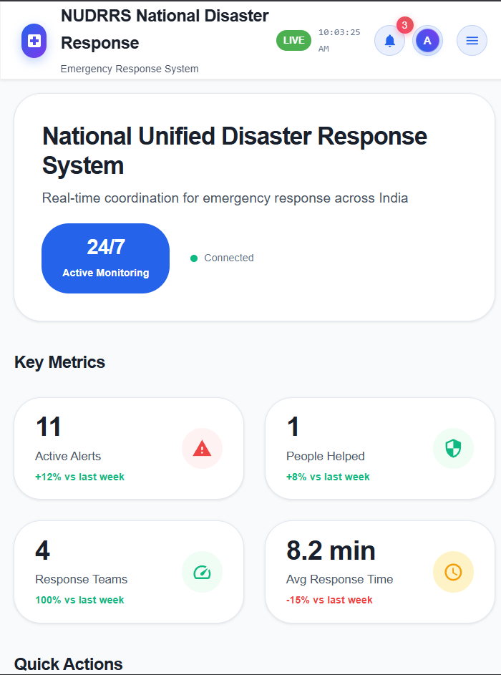
NUDRRS: AI-Powered Emergency Response System
Revolutionizing disaster management through intelligent documentation and rapid response coordination for emergency responders and government agencies.
Smart India Hackathon 2025 | Team HackerXHacker

Slide 2
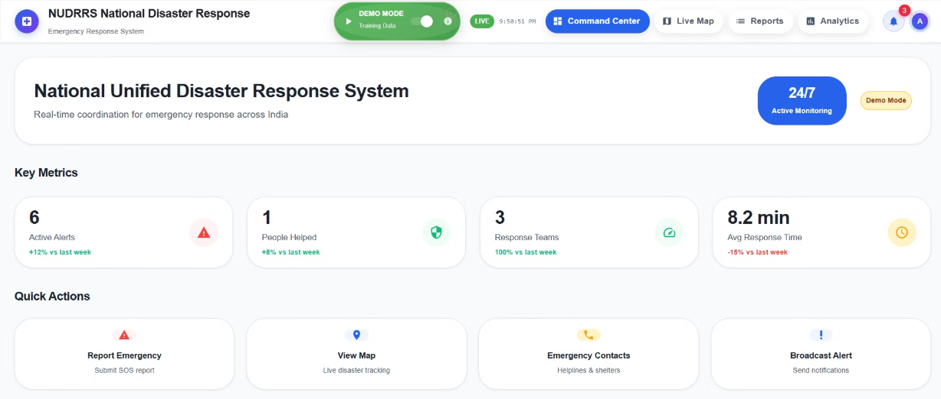
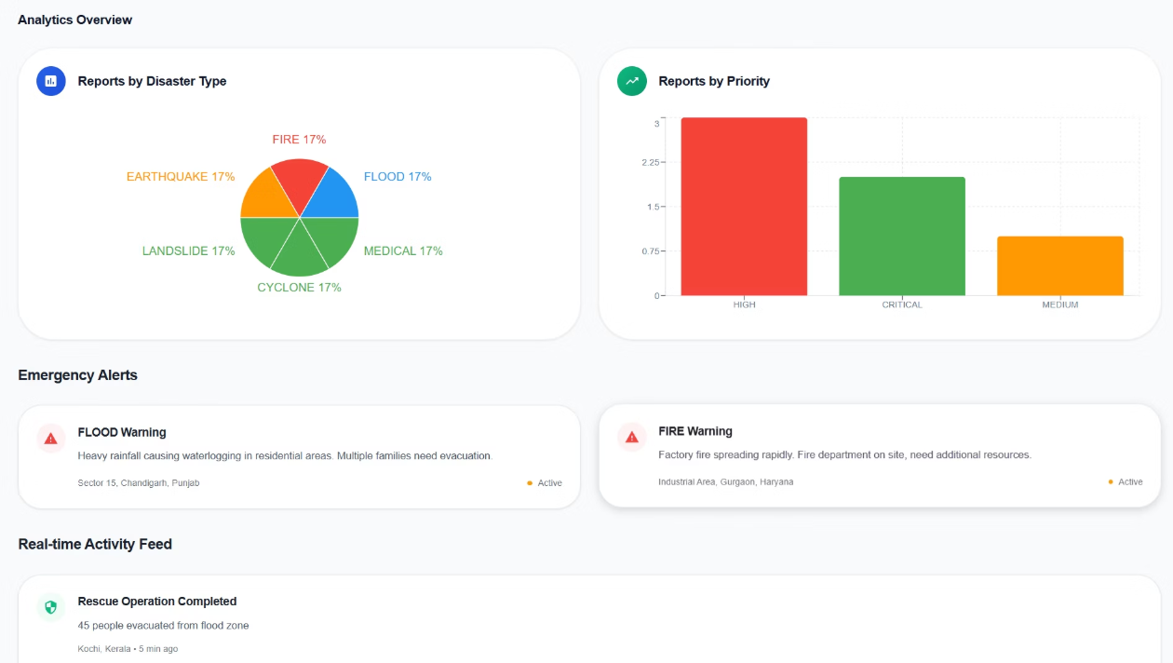
What is NUDRRS?
National Unified Disaster Response & Relief System
NUDRRS is a cutting-edge AI-powered platform designed specifically for emergency management professionals. This cloud-based system transforms how disaster response teams create, share, and coordinate critical documentation during crisis situations.
Generate professional emergency reports in minutes
Real-time collaboration for response teams
No technical expertise required
Seamless integration with existing emergency protocols

Slide 3
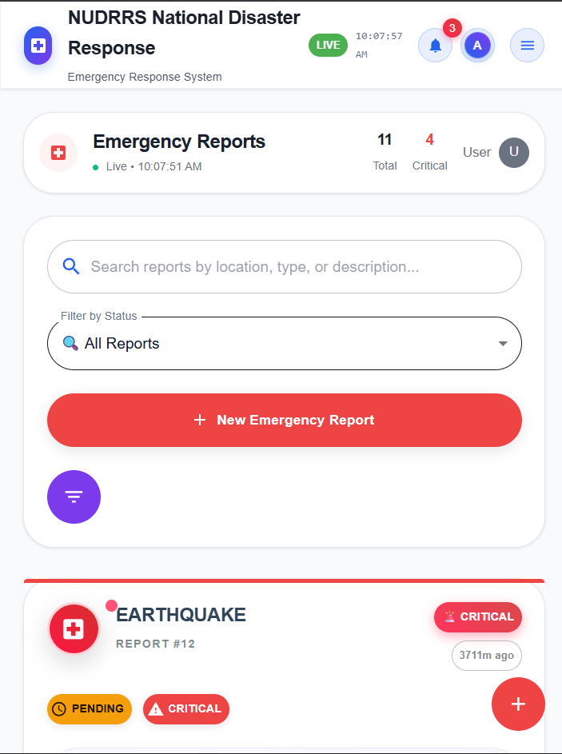




Core Emergency Response Capabilities
AI-Generated Reports
Transform incident details into structured, professional emergency documentation automatically
Smart Crisis Design
AI-driven layouts optimized for clear emergency communication and rapid information processing
Real-Time Coordination
Enable multiple response teams to collaborate simultaneously on critical incident documentation
Official Branding
Maintain agency credibility with proper logos, colors, and governmental formatting standards

Slide 4




Emergency Response Workflow
Input Emergency Details
AI Content Generation
Customize & Deploy
Enter disaster type, location, severity level, and incident specifics. Select appropriate report format for your response needs.
Advanced algorithms structure information logically, create clear headlines, and suggest optimal visual layouts for maximum impact.
Apply agency branding, enable team collaboration, and distribute immediately to stakeholders and authorities.
Time Savings: Traditional emergency report creation takes 2-4 hours. NUDRRS reduces this to 15-30 minutes, enabling faster response deployment.

Slide 5
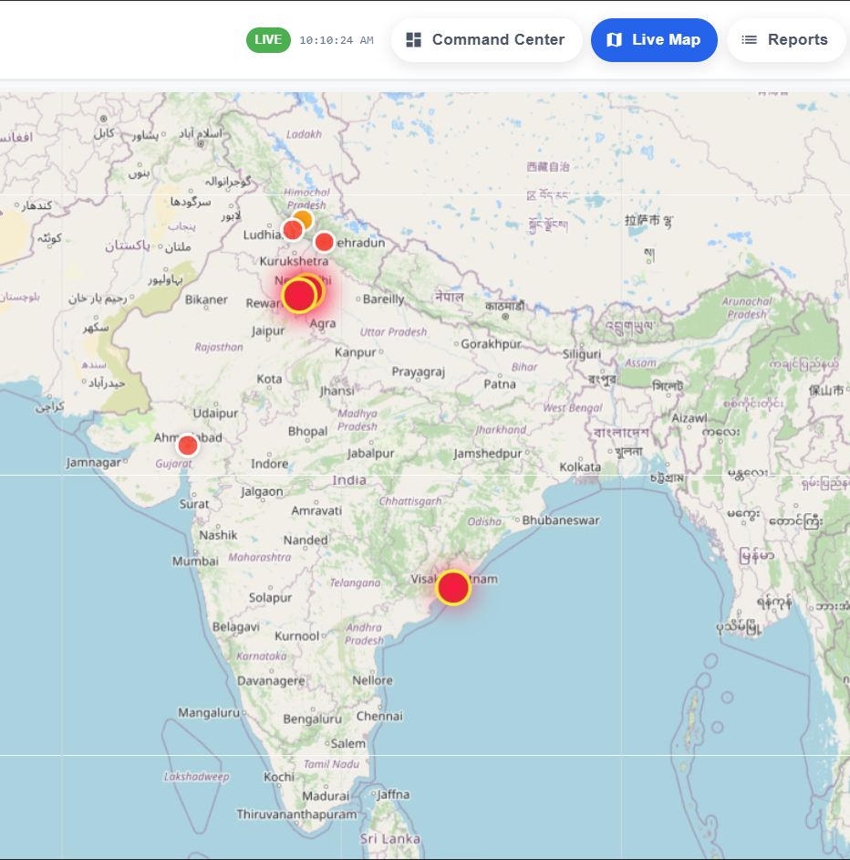




Emergency Management Stakeholders
Emergency Response Teams
Create rapid incident reports, situation briefings, and field coordination materials for immediate deployment and decision-making.
Government Agencies
Produce official disaster communications, public alerts, and inter-agency coordination documents with proper governmental formatting.
Disaster Authorities
Generate comprehensive emergency presentations, resource allocation reports, and multi-jurisdictional response coordination materials.
Information Officers
Develop crisis communication materials, media briefings, and public awareness campaigns with consistent professional quality.

Slide 6

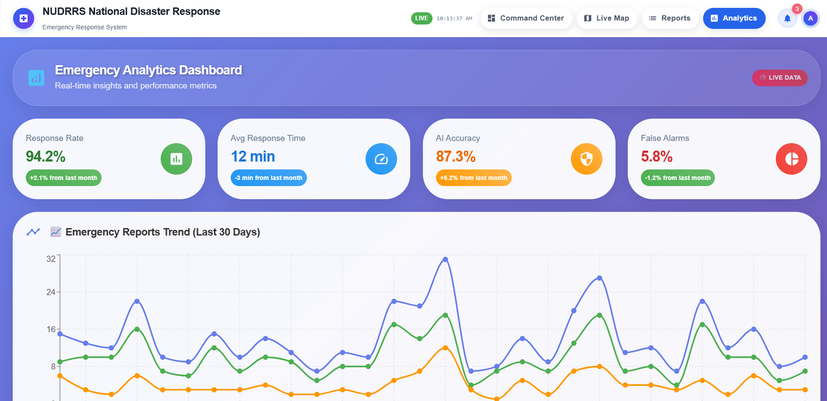

Why Choose NUDRRS for Emergency Management?
Rapid Response
Generate emergency reports in minutes instead of hours, enabling immediate action when every second counts during crisis situations.
Professional Quality
Government-grade templates and AI suggestions ensure consistent, credible documentation that meets official standards.
Cost-Effective
Affordable pricing designed for government budgets and NGO constraints, with flexible plans for any organization size.
Performance Impact: Agencies using NUDRRS report 70-80% faster documentation creation and improved response coordination effectiveness.

Slide 7
Flexible Pricing for Emergency Organizations
1
2
3
Free Plan
Professional Plan
Enterprise Plan
$0/month
$5/month
Custom Pricing
Basic emergency report creation
Unlimited emergency presentations
Multi-agency collaboration tools
5 disaster templates included
Full government branding suite
Advanced team management
Standard sharing capabilities
Advanced emergency analytics
Government-grade security
Community support access
Priority crisis support
24/7 emergency support
Custom emergency domains
API integration capabilities

Slide 8
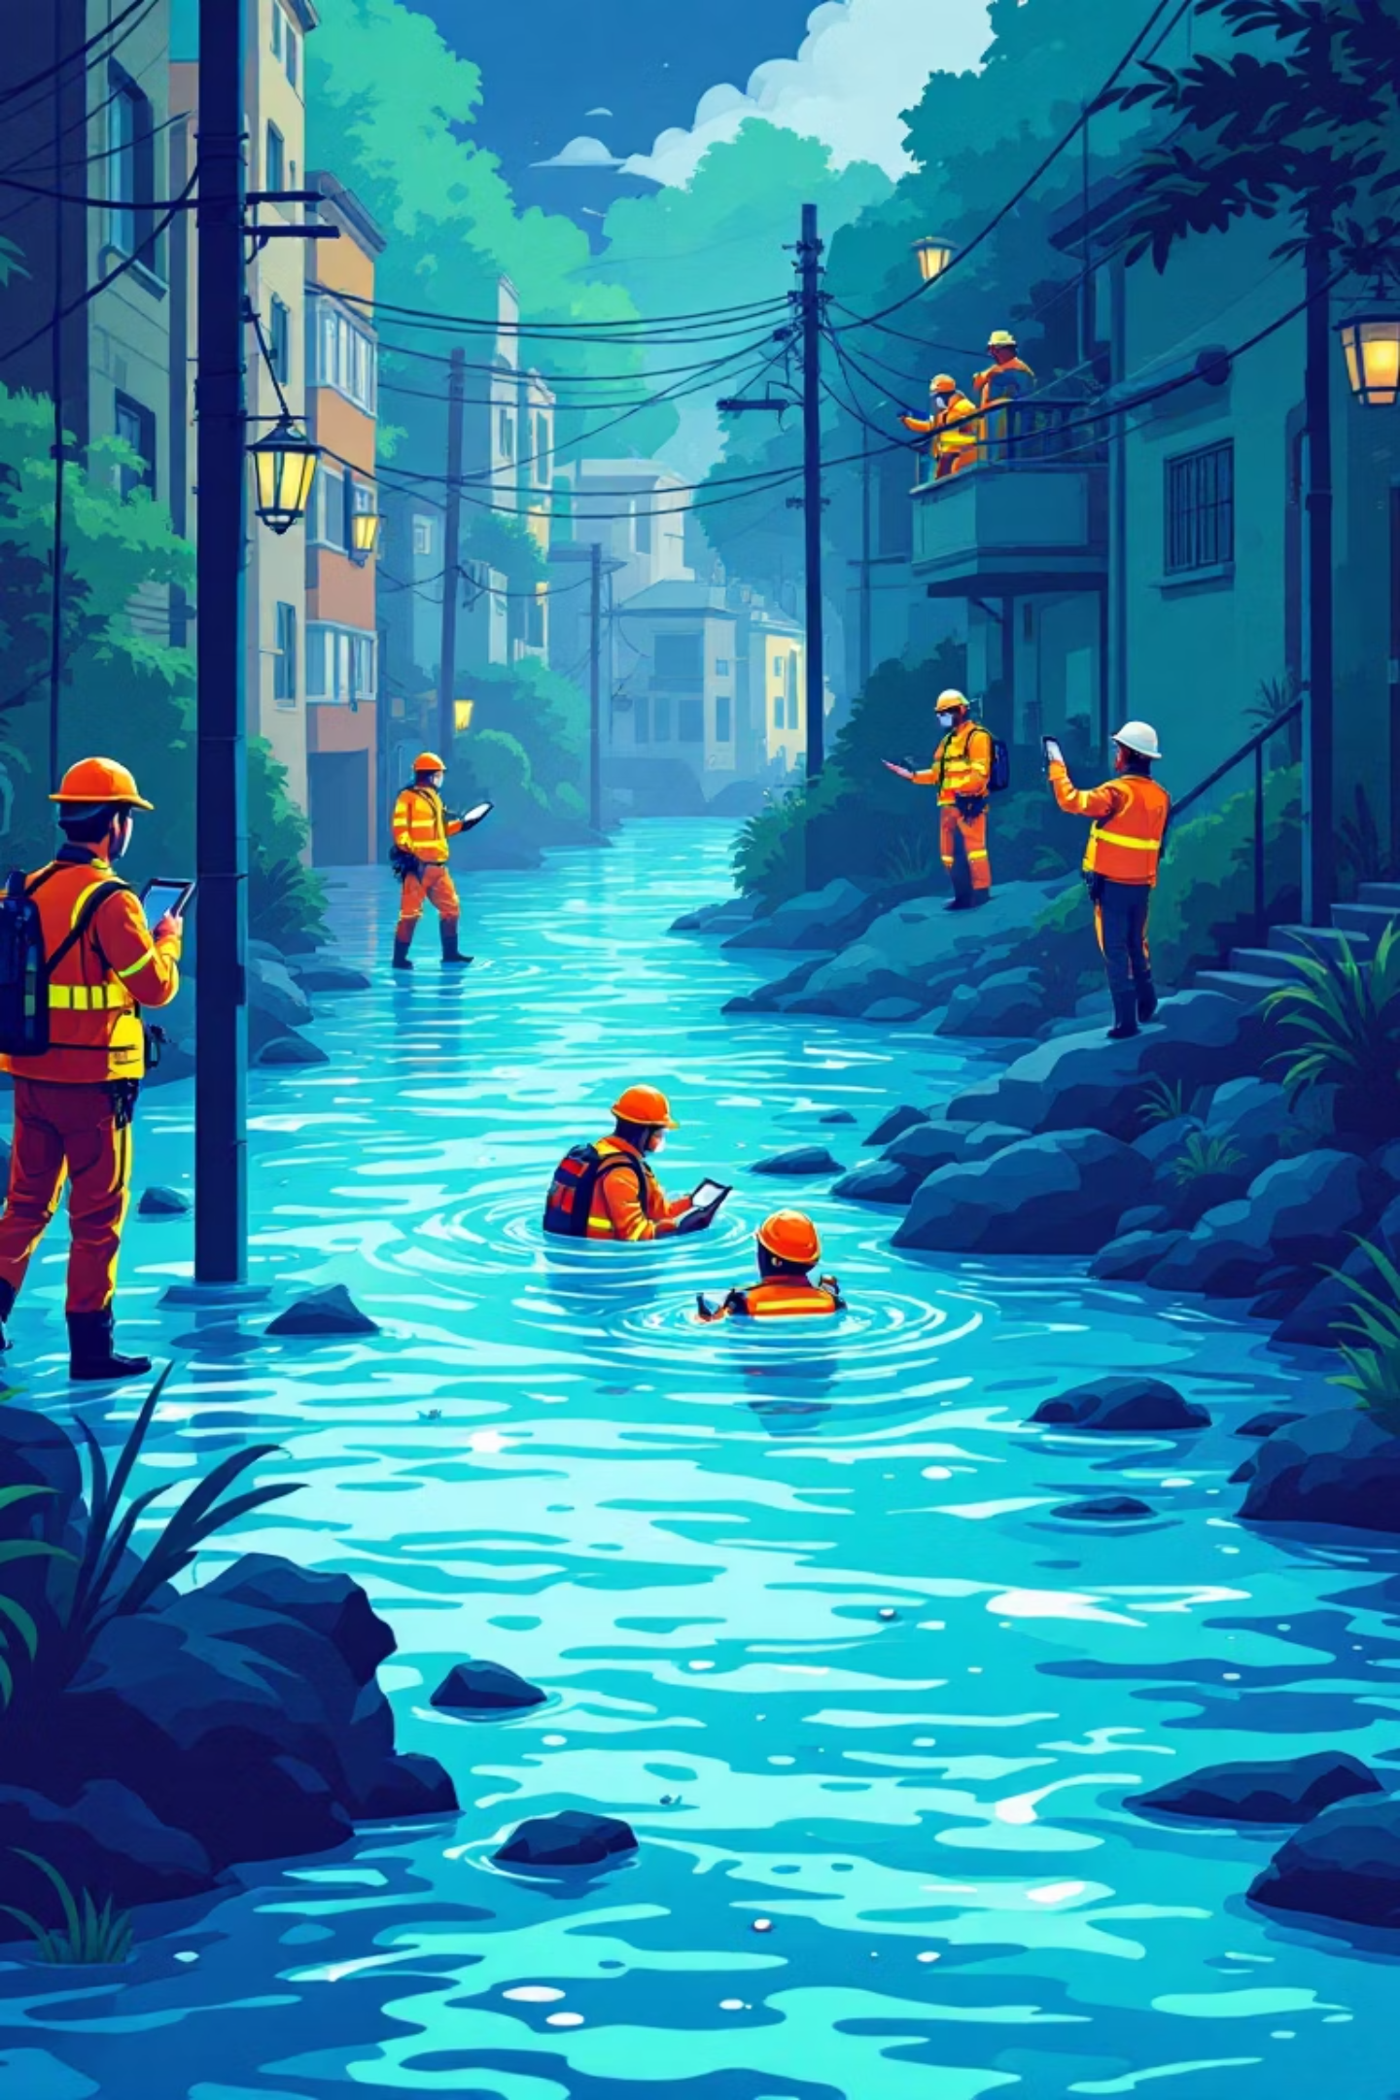
Real-World Emergency Applications
1
Flood Response Coordination
Emergency teams create detailed situation reports, evacuation plans, and resource deployment documentation in minutes rather than hours.
2
Earthquake Relief Operations
Generate interactive damage assessment presentations and coordinate multi-agency response efforts with real-time collaboration tools.
3
Fire Department Reporting
Produce incident reports, public safety briefings, and after-action reviews with professional layouts and consistent formatting.
4
Public Crisis Communication
Develop official disaster declarations, public alerts, and community awareness materials with appropriate governmental branding.

Slide 9

The Future of Emergency Communication
Current State
Manual emergency documentation requires hours of work, often delaying critical response decisions and public communications.
NUDRRS Impact
AI-powered automation enables immediate professional documentation, accelerating response times and improving coordination effectiveness.

Slide 10


Transform Your Emergency Response Today
🌐 Access NUDRRS
Visit our platform and explore emergency management capabilities designed specifically for your operational needs.
🆓 Start Free Trial
Begin with our comprehensive free plan to experience AI-powered emergency documentation firsthand.
📝 Create First Report
Generate your initial AI-powered emergency presentation and witness the dramatic time savings and quality improvement.
👥 Invite Your Team
Enable real-time collaboration with emergency response team members for coordinated documentation efforts.
Key Takeaways
AI revolutionizes emergency communication speed and quality
NUDRRS makes professional emergency reports accessible to all agencies
Critical time savings during disasters improve overall response effectiveness
Start creating better emergency documentation today
Questions & Discussion

